Slide 1
Magic: The Gathering
Online Metagame and Pricing Analysis Data Visualization Track
By: Davin Frankosky
Notes:
UNC Data Analytics Bootcamp - Project 3

Slide 2
Project Background

Slide 3
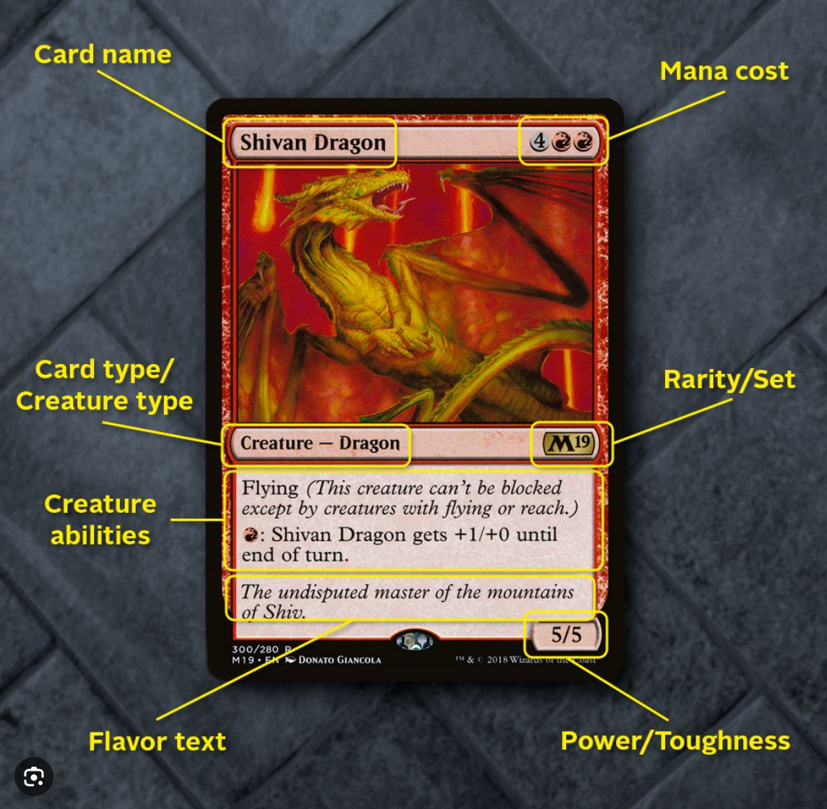
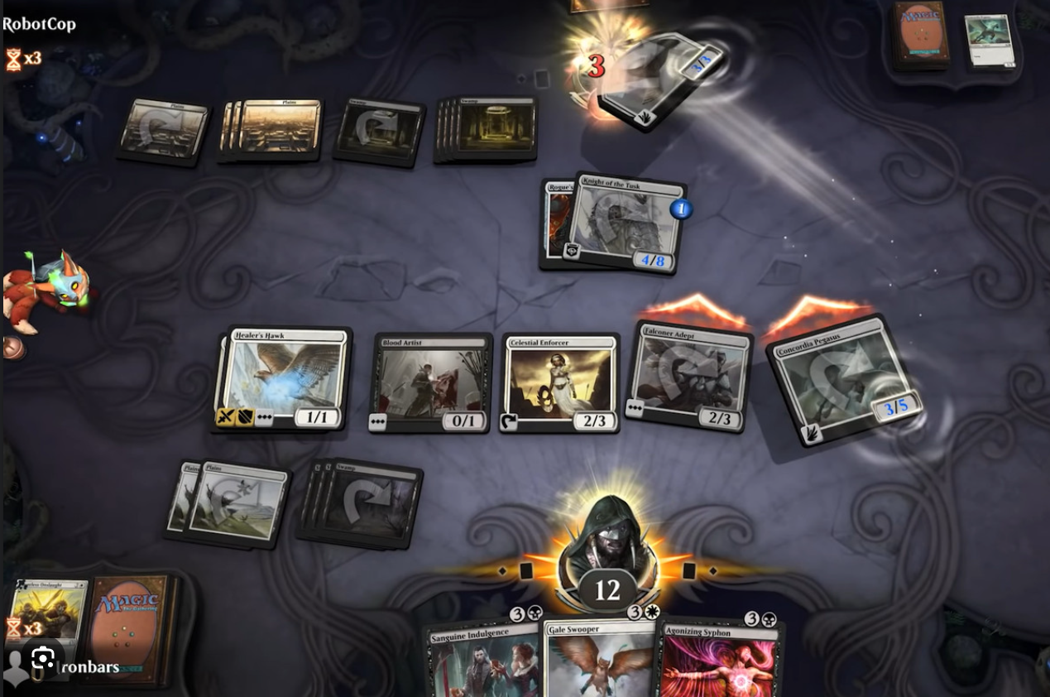
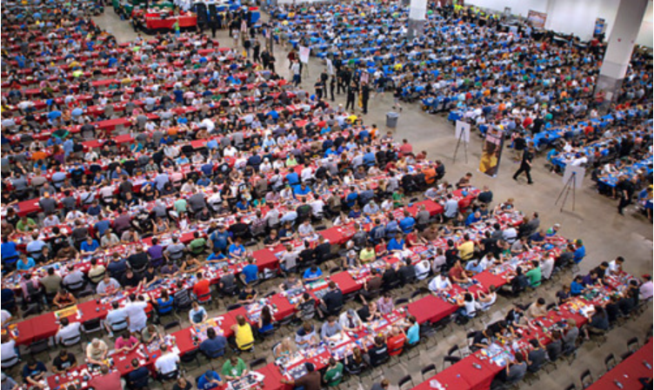
What is Magic: The Gathering (MTG)?
Opponents select cards from a large pool of options (thousands) to build a custom deck. The pool of options is defined by the ‘format’ being played.
Think Chess, but instead of pieces, there are cards and every card does something different. Some cards have unique interactions with others.
Decks must be at least 60 cards, and can only contain up to 4 copies of most cards. Objective is to get opponent’s life from 20 to 0.
Large tournament scene and economy.
Notes:
Imagine chess, except both choose their own unique collection of pieces to play with. Also, the pieces have abilities and interactions.
For example, imagine in chess if you had a knight that said “When this moves, your next pawn move can be in any direction”.
Cards have specific metadata

Slide 4
Why?
Metagame analysis: Highlight trends in the tournament scene to better inform deckbuilding decisions.
Potentially discover investment opportunities for emerging cards.
Continue to build out functionality for a fun hobby and share with friends!

Slide 5
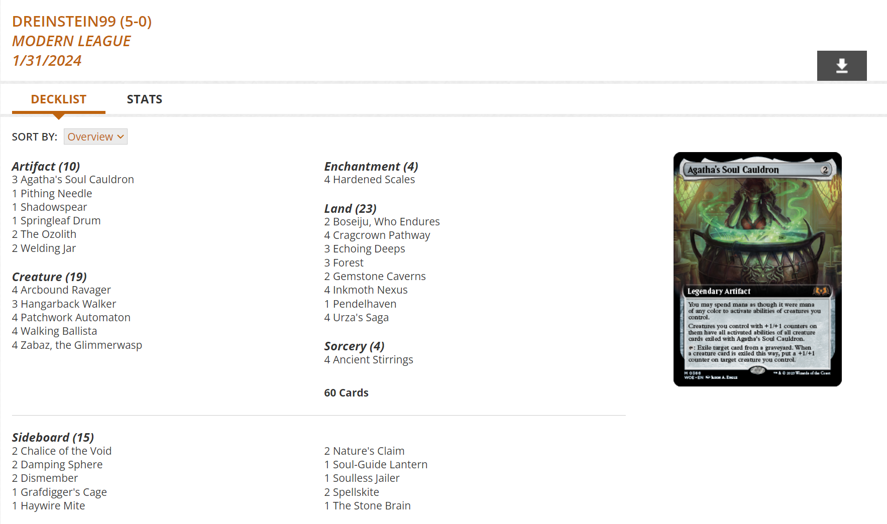
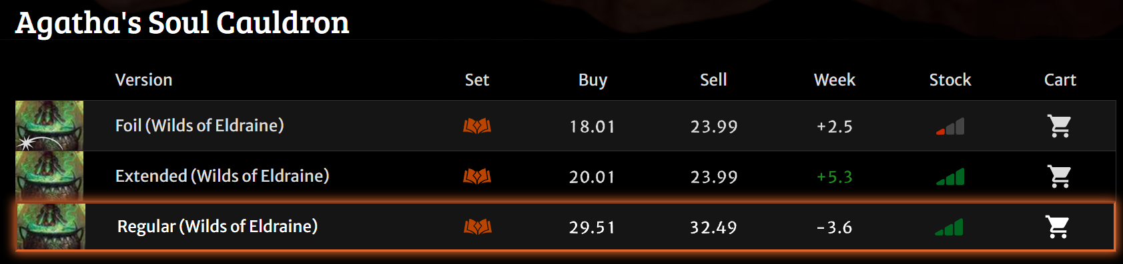
Tournament, Card, and Pricing Data
Results from tournaments held on Magic: The Gathering Online (MTGO) are publicly available on https://www.mtgo.com/decklists.
Bots buy and sell cards on MTGO. Goatbots.com is one of the largest dealers, and they generally set the market for card valuation.
Card metadata available through the MTG API: https://docs.magicthegathering.io/

Slide 6
Dataset and Process

Slide 7
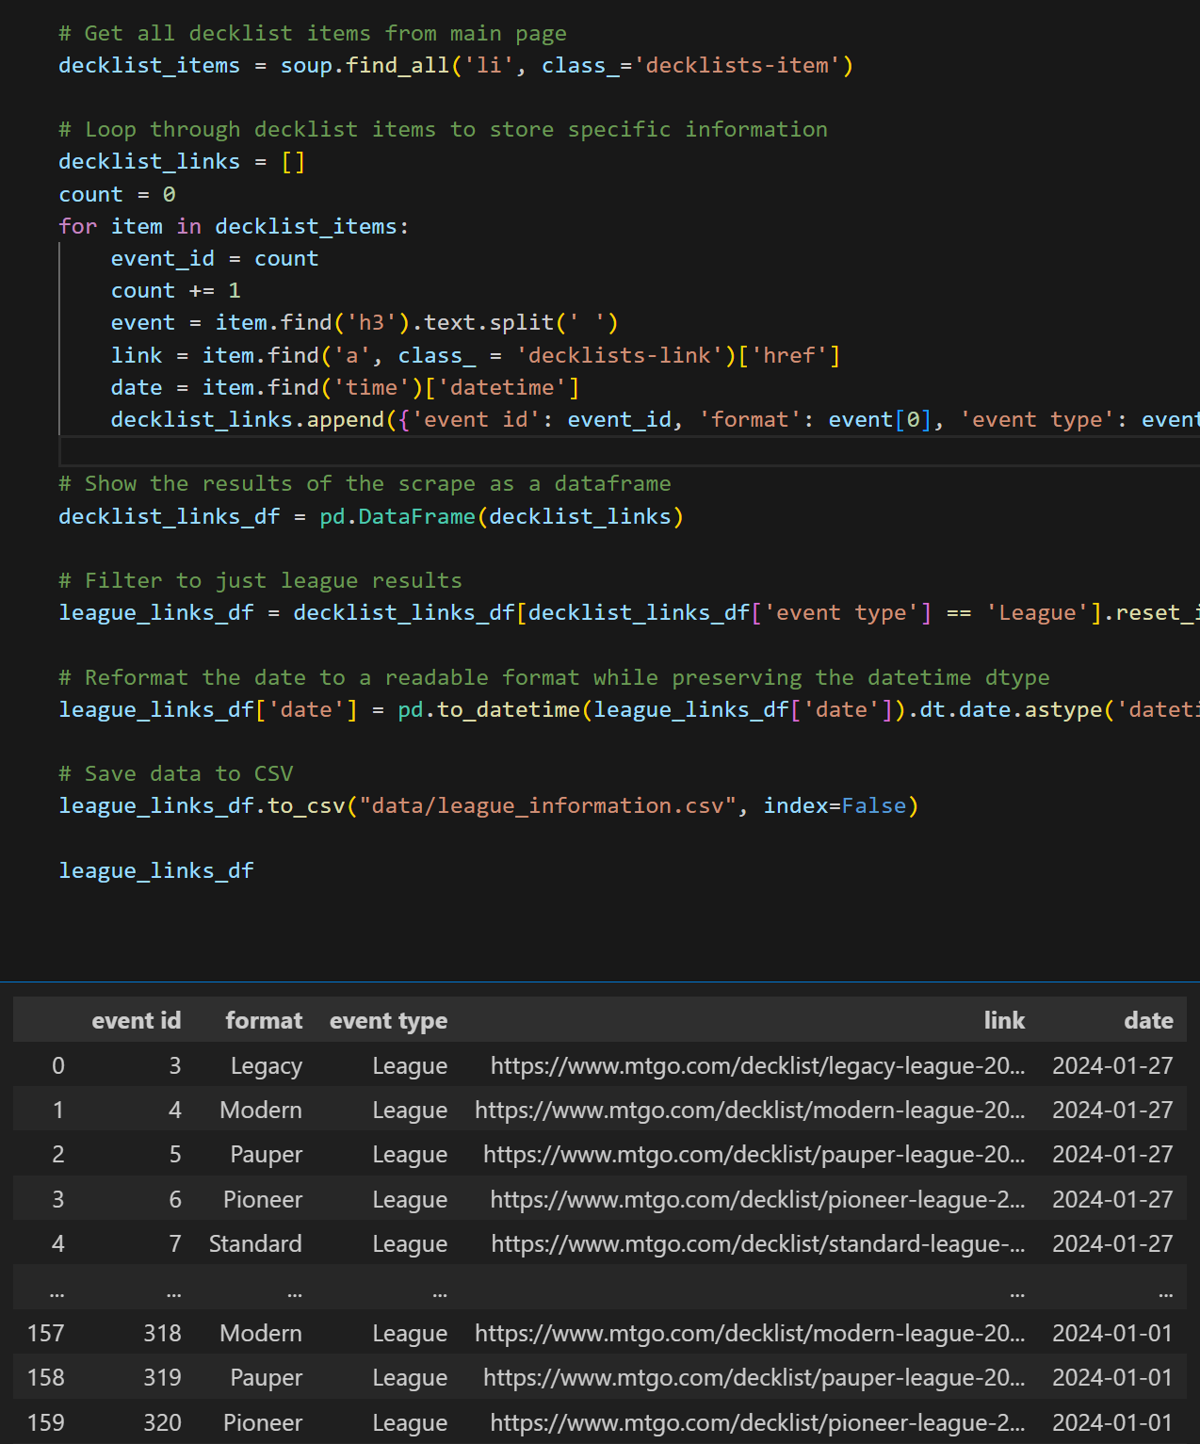
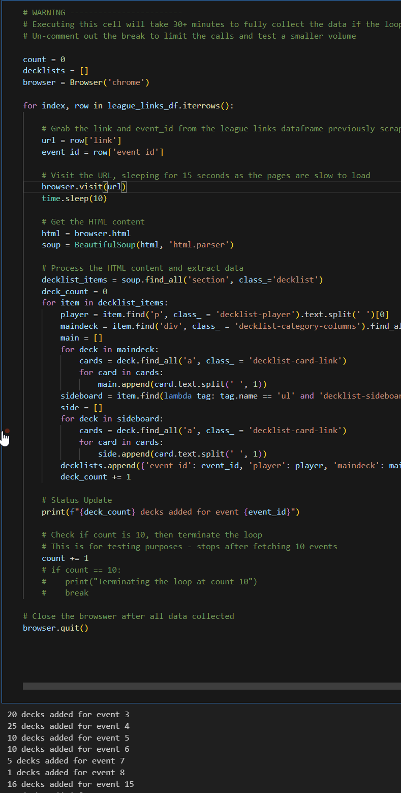
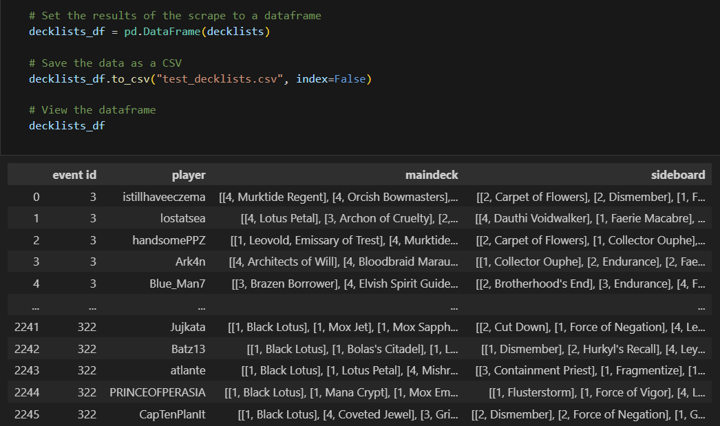
Dataset and Process
1 - Data Scraping
Use Python with BeautifulSoup to scrape decklist data from https://www.mtgo.com/decklists for January 2024 YTD. These are all decks that went 5-0, and establishes the metagame.
Build dataframes in Python with Pandas with event, deck, and card information.
Keep in mind unique IDs to be used as primary keys later across tables.
Loop through each tournament event
Store decklists as a list for each event

Slide 8
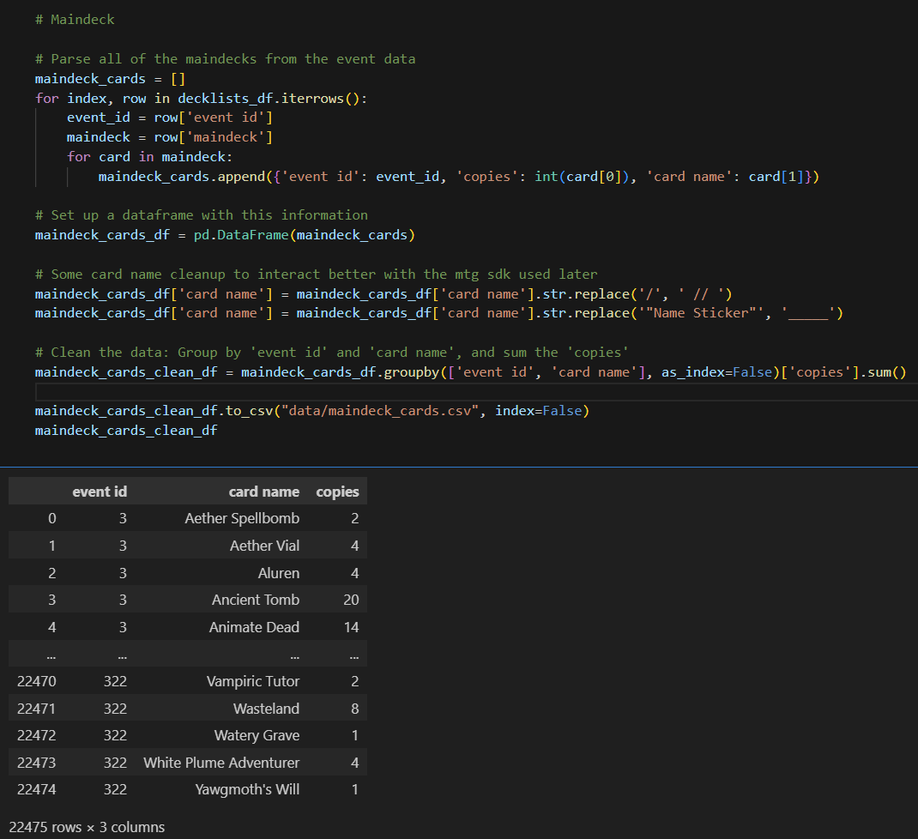
Dataset and Process
2 - Decklist Cleaning
Parse out each card and the number of copies.
Had to return to this a number of times once I started interacting with the MTG API for card information due to discrepancies in card name formatting.
Loop through each deck
Notes:
Note: As a future project, I need to use the eventID and player name to create another unique ID: Deck ID. The way this project is done now, after data cleaning, I don’t have number of decks in a given event to show format popularity.

Slide 9
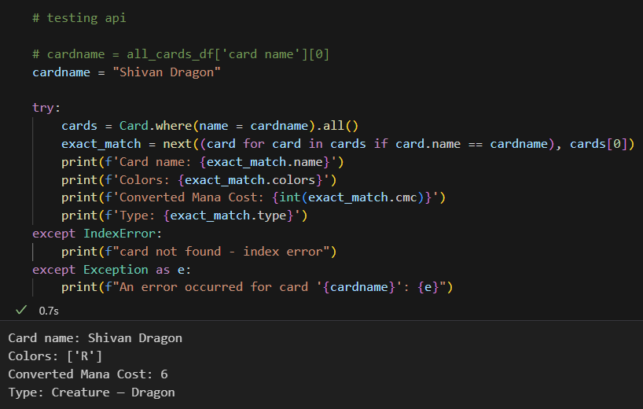
Dataset and Process
3 - API Testing - Retrieve Card Metadata
Use the MTG API via Python package mtgsdk.

Slide 10
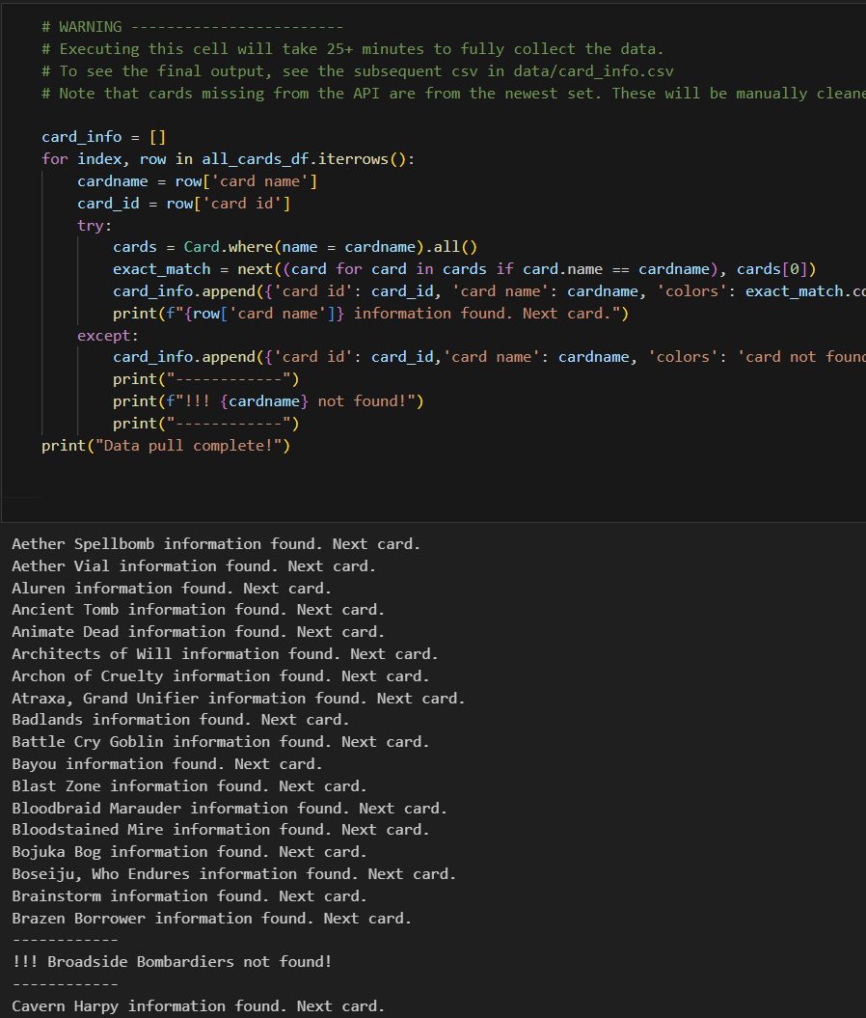
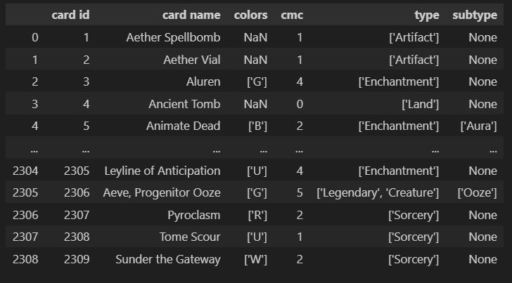
Dataset and Process
4 - Store Card Metadata
Loop through all cards and use the API to store their metadata in more dataframes.
Manually filled in some gaps as some very new cards were not in the API.
List-ify cards with multiple attributes

Slide 11
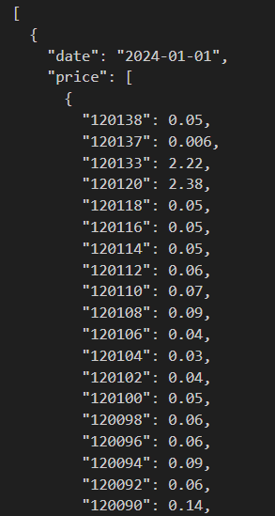
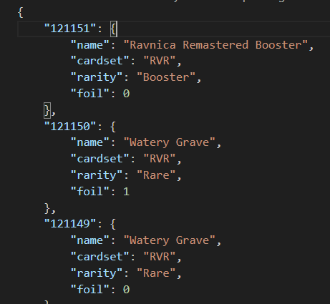
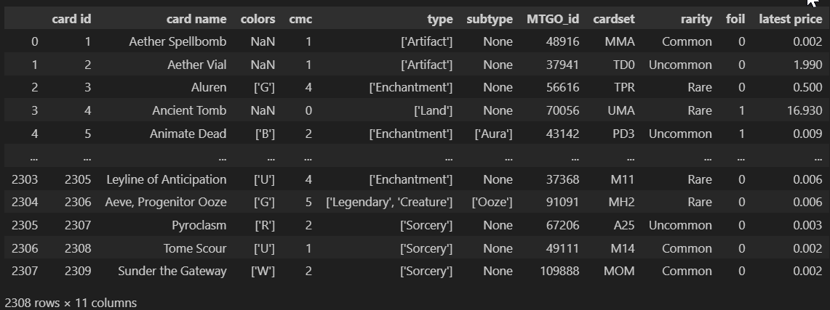
Dataset and Process
5 - Import Pricing Information
Daily pricing history from goatbots.com. Wrote a python script to collate these into a master JSON file with date, card ID, and price keys.
Multiple versions exist for each card name on MTGO, each with a different price. Synced my card ID with the MTGO ID of the lowest priced version for this project.
Notes:
If I were to redo it, I would have worked backwards from the pricing spreadsheet and used their MTGO_ID as my Primary key throughout!

Slide 12
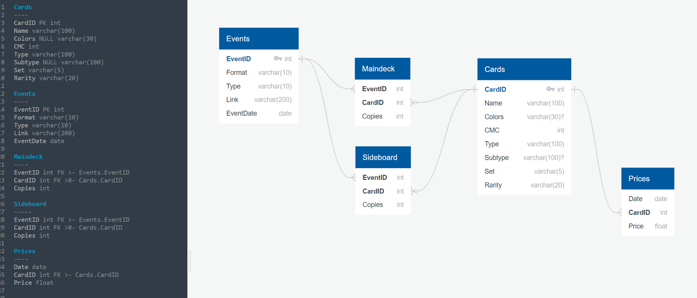
Dataset and Process
6 - Set up SQL Database
SQL is chosen because my dataset is very consistent and well defined: Every card has virtually the same set of non-ambiguous metadata.
Notes:
Events have Decks, Decks have Cards, Cards have Prices

Slide 13
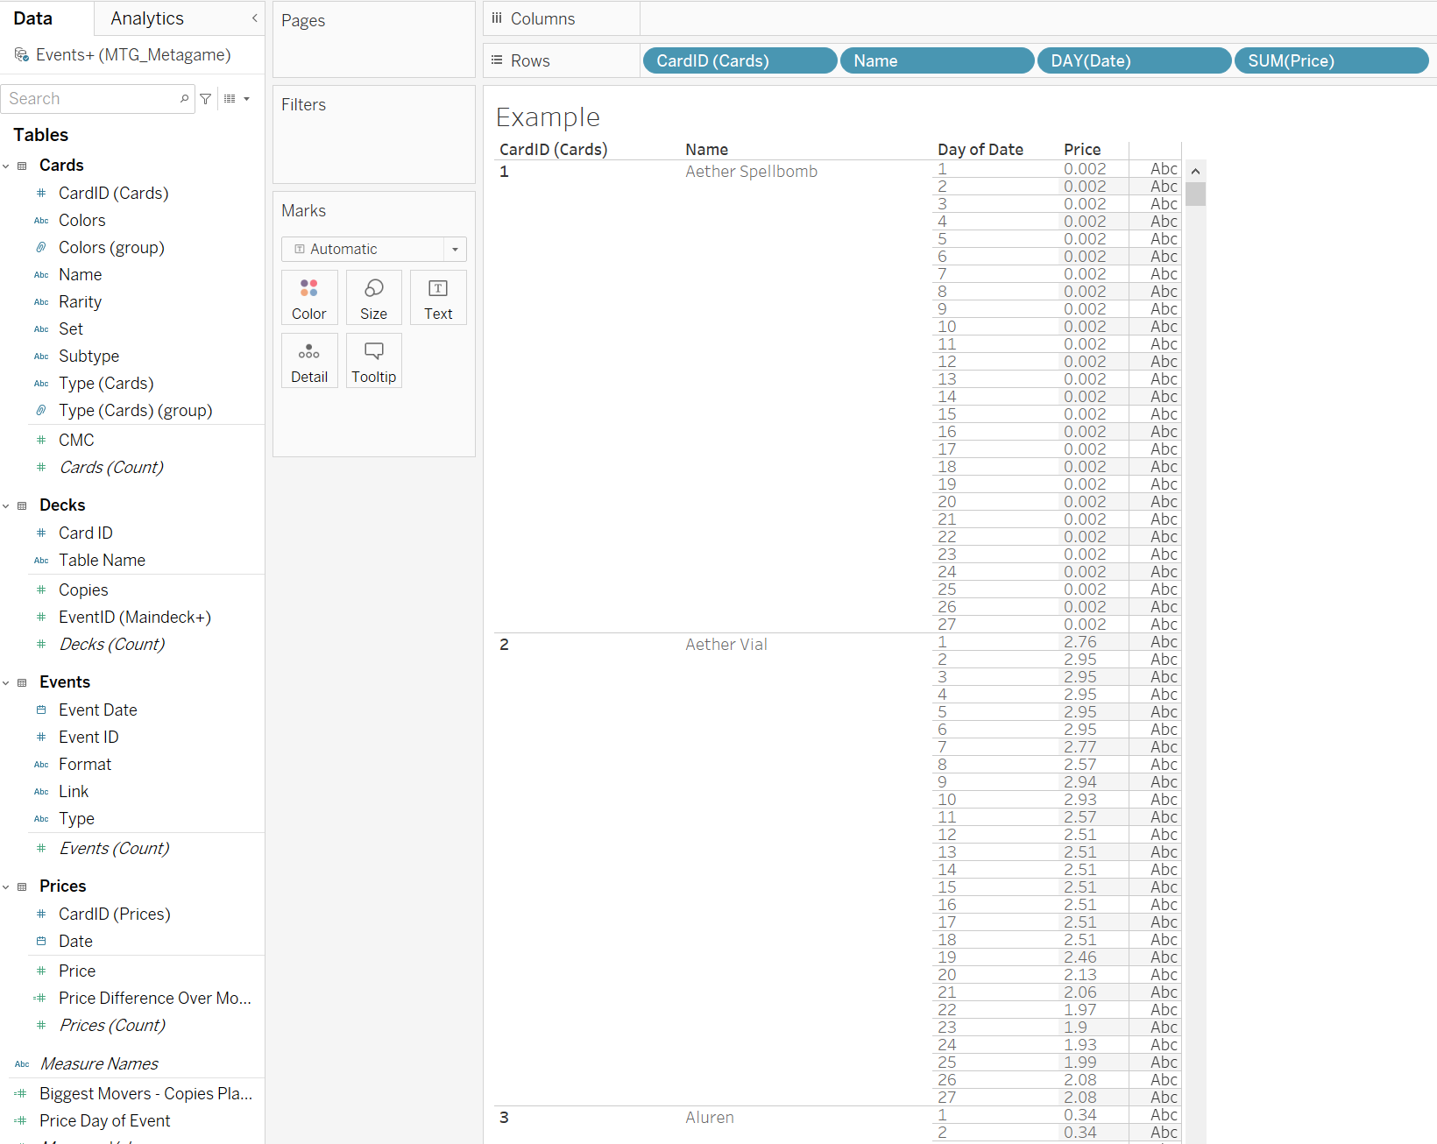
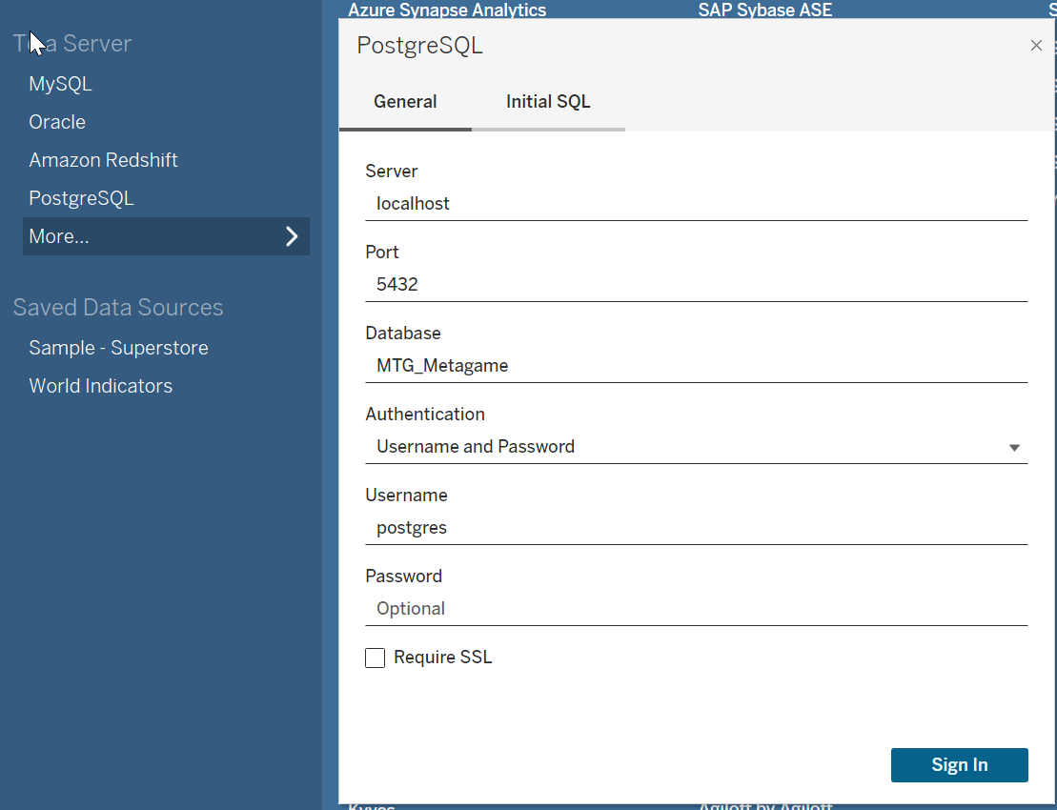
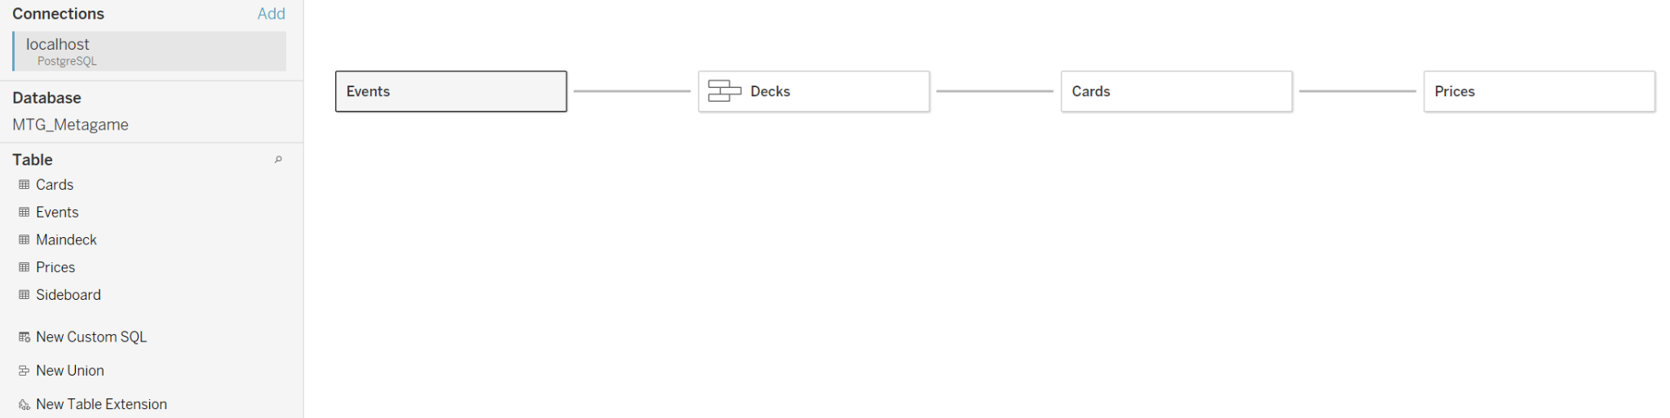
Dataset and Process
7 - Connect to Tableau
Connect my PostgreSQL Database to Tableau for visualizations
Manipulate Data
Connect
Relate Tables

Slide 14
Visualizations

Slide 15
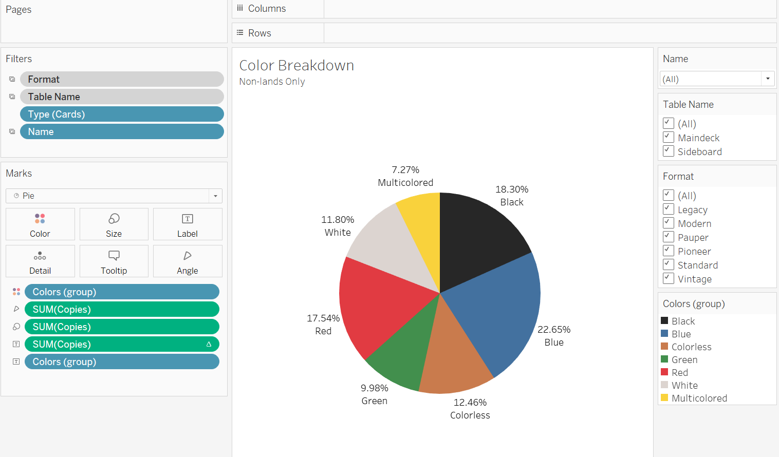
Visualizations
1 - Create Visualizations
Use tables and filters to plot data
User friendly drag-and-drop functionality

Slide 16
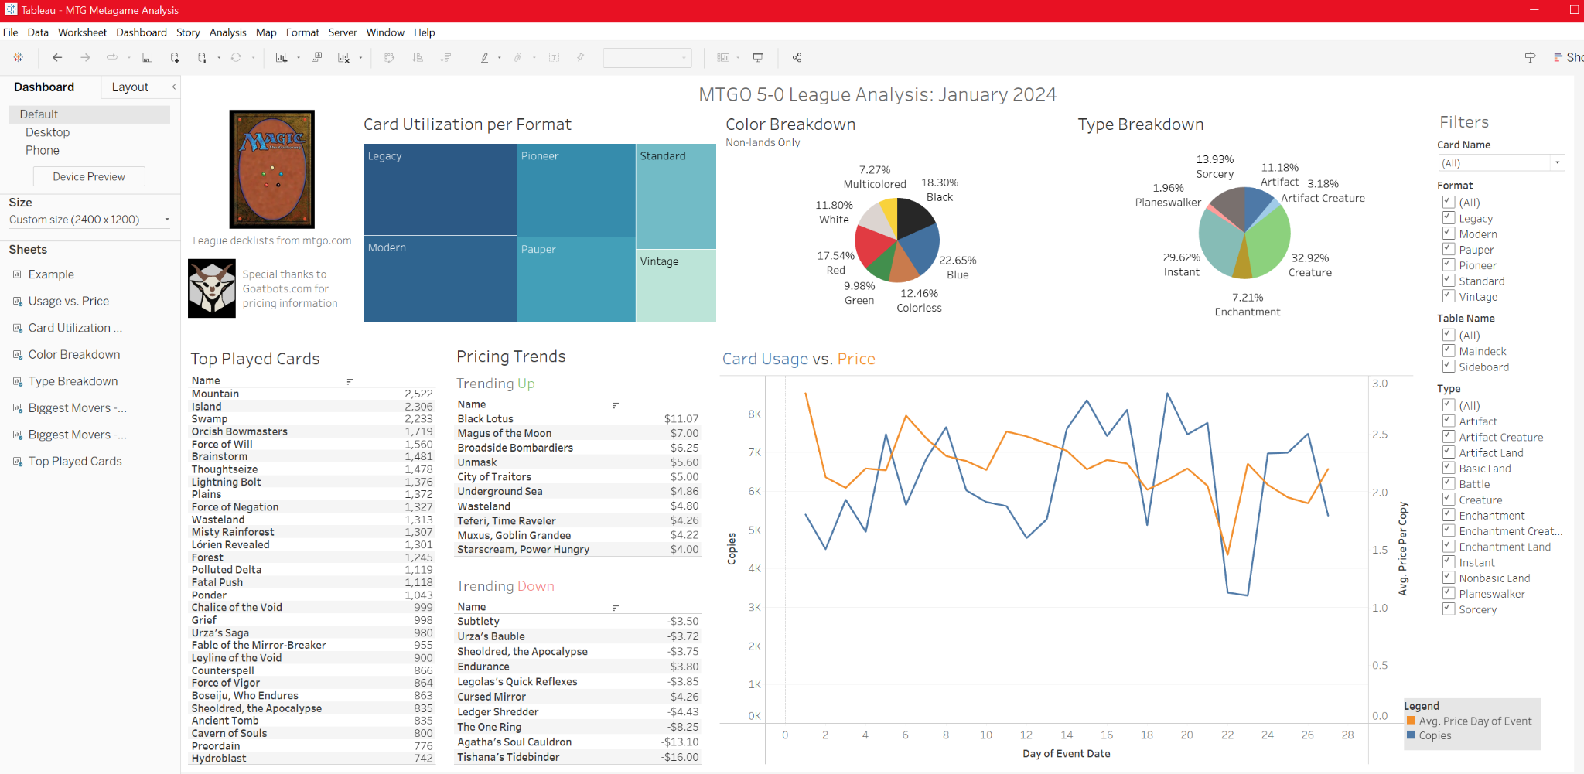
Visualizations
2 - Collate to Central Dashboard

Slide 17
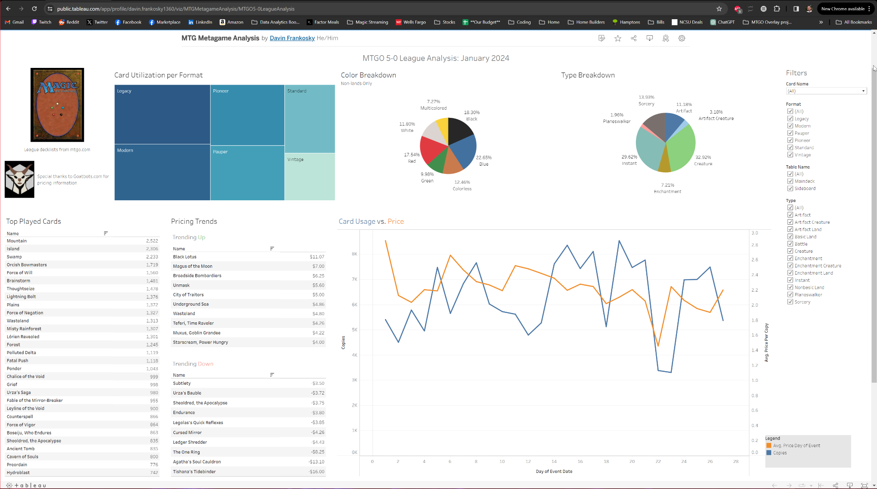
Visualizations
3 - Publish to Tableau Public

Slide 18
Live Demo

Slide 19
Ethical Considerations

Slide 20
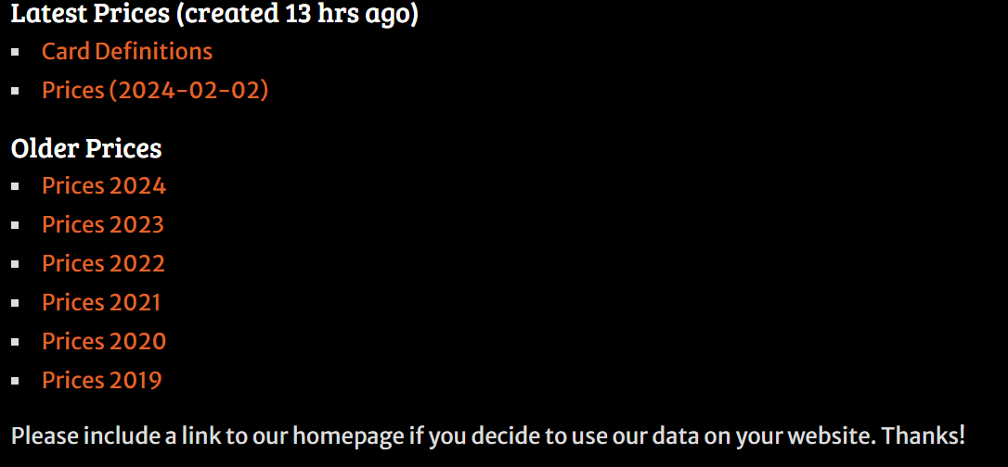
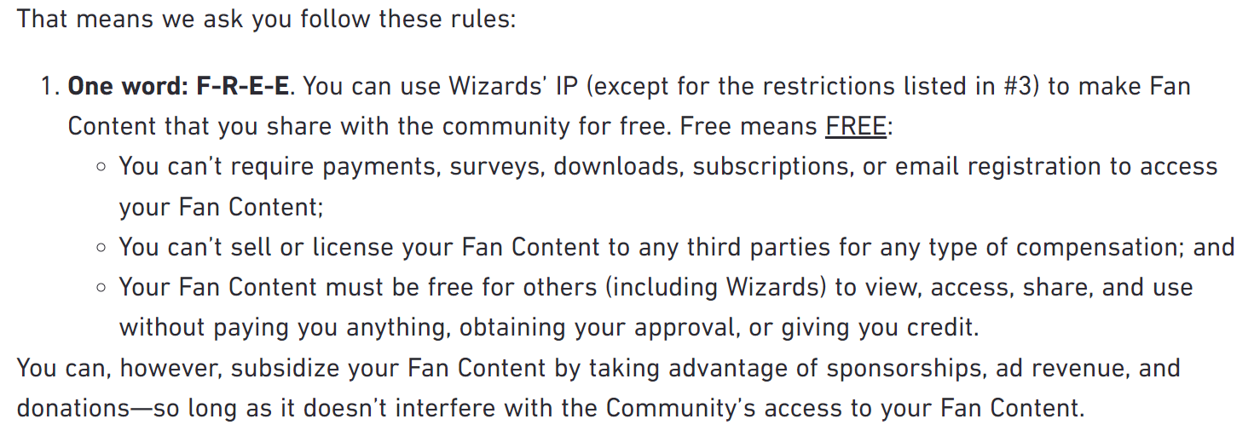
Ethical Considerations
Cite sources, give credit:
Avoided displaying Personally Identifiable Information (PII)
Follow MTG API rate limits and reference the MTG SDK MIT free use license.
Follow Wizards of the Coast Fan Content policy

Slide 21
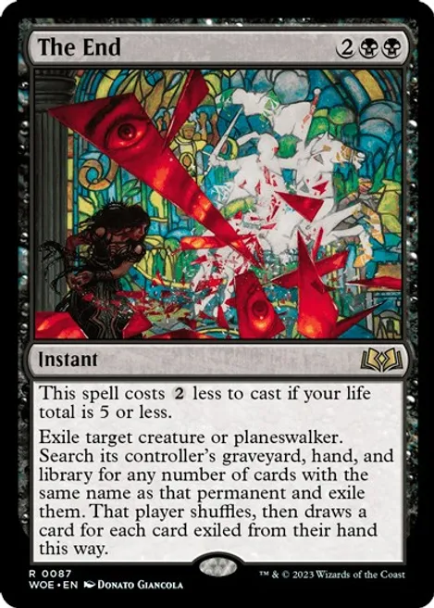
Questions?

Slide 22
Appendix

Slide 23
Dataset and Process - Summary
Use Python to scrape card data from https://www.mtgo.com/decklists, (specifically format leagues) for all of January 2024. These are all decks that went 5-0.
Build dataframes in Python (format, date of tournament, total number of copies of each card, card name)
Utilize Python-based library, MTG SDK (https://github.com/MagicTheGathering/mtg-sdk-python), to pull in additional information for cards
Push this info to a Postgres SQL database.
Pull data from my Database using Tableau for Visualizations.

